Slide 1

基于Microsoft Teams 构建应用集成和工作流 陈 希章 | 微软（亚洲）互联网工程院
实施 Microsoft 身份（一）
实施 Microsoft 身份（二）
Microsoft Graph 简介
扩展 Microsoft SharePoint
扩展 Microsoft Teams (一）
扩展 Microsoft Teams (二）

Slide 2
实施 Microsoft 身份（第 2 段，共 2 段）
使用 Microsoft 身份保护自定义 API
在自定义应用和 API 中与用户、组和角色一起工作

Slide 3
使用 Microsoft 身份保护自定义 API
概述 – 使用 Microsoft 身份保护自定义 API
从 Web 应用调用受保护的 API
从守护进程应用调用受保护的 API
Notes:
Many solutions involve creating web APIs to expose functionality to different clients and consumers. Developers can secure these APIs using Microsoft identity to ensure only approved apps can access the web APIs provided they've been granted the necessary permissions.
In this section, you’ll learn how to secure a web API with Microsoft identity and how to call it from another application.

Slide 4
概述 – 使用 Microsoft 身份创建和保护自定义 API

Slide 5
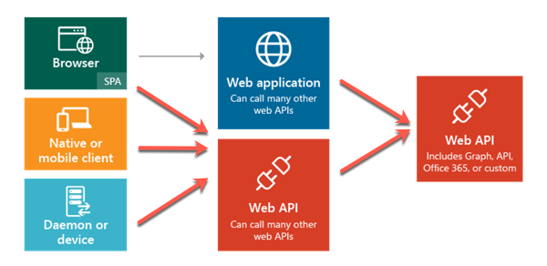
使用 Microsoft 身份保护 Web API
确保自定义 Web API 的安全，以保护 LOB 系统免受自定义应用的影响
Notes:
Microsoft identity can be used to secure a custom web API so only authenticated users and applications can access it. You can use custom web APIs to expose line-of-business applications and systems that should be protected with a trustworthy identity platform such as Microsoft identity.
Once an API has been secured with Microsoft identity, you can enable users and apps to authenticate and access the web APIs though many different types of applications including desktop, mobile, web, and services or daemons. The Microsoft identity platform is a great solution for securing APIs especially when your users and their data are secured with Microsoft identity.
For example, consider the scenario where a company in Office 365 sells categories of products to their customers. Your inventory management system needs to allow certain employees read-only access to products while others can create, edit, and discontinue products. The inventory management system can be developed to leverage multiple APIs, from custom APIs to manage the product inventory to Microsoft Graph to look up different employees.
Another option is to create a custom domain-specific web API that abstracts the calls to these different APIs and line-of-business systems from the inventory management system developers. The custom web API should be secured and only grant some users limited permissions while other users can perform more privileged actions.

Slide 6

谁将使用你的应用？
人类
组织中的员工 (LOB)
来自为你的应用 (SaaS) 付费的机构的员工
合作伙伴 (B2B)
消费者 (B2C)
终止器（应用/服务）：
代表用户
自主
Notes:
When securing an app with Microsoft identity, you need to think about who will access the app.
Will the users of your app be employees in your tenancy, partners in a business-to-business (B2B) scenario, customers in a business-to-customer (B2C) scenario?
Or is the primary use case one where you've created a web API, secured using Microsoft identity, that's primarily called by other applications.

Slide 7
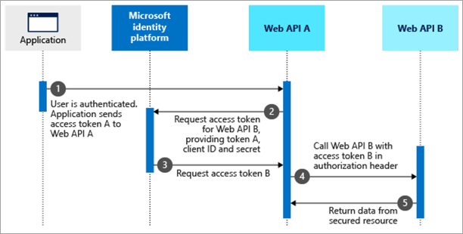
使用应用（终止器）访问 Web API
在本模块中，我们重点讲解上图中的最后一个选项：终止器。
Notes:
For now, we're focusing on the last option in the figure above: terminators. A terminator is an application or service that communicates with your custom web API secured using Microsoft identity. There are two types of terminator applications: one that acts on behalf of a user, and one that acts on behalf of itself.
The first option, on behalf of, is when a user authenticates and uses an application that will then make a request, on behalf of the user, to the secured web API.
In the second option, the application acts as a service or daemon where there's no user interaction. In this case, the app acts as itself. Daemon apps authenticate with Microsoft identity, obtain an access token, and include the token in the authorization header value of each HTTP request to the web API.
But, before you can build applications that implement either the on behalf of or daemon scenarios, you must first create and secure the web API.

Slide 8
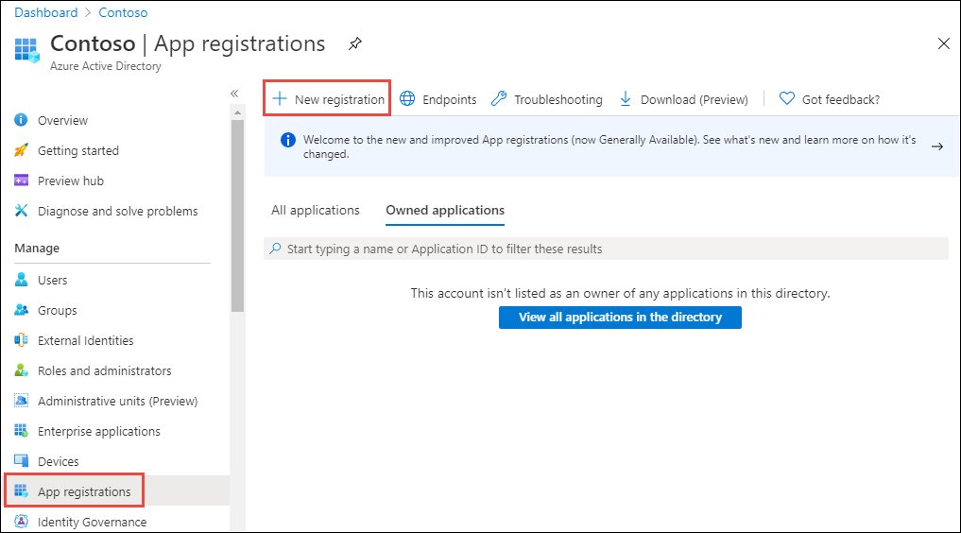
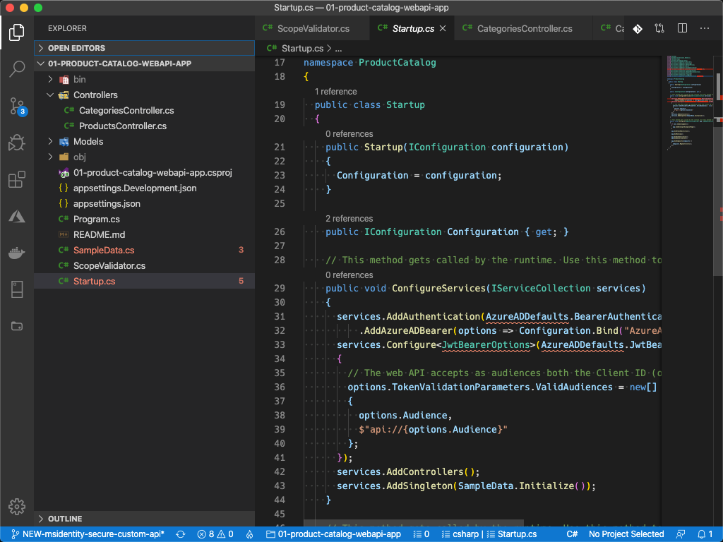
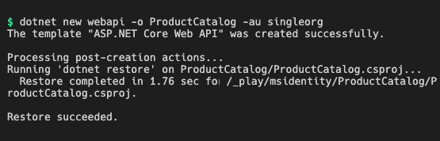
创建由 Microsoft 身份保护的 Web API
注册和配置 Azure AD 应用
创建新 Web API 项目。
编码 Web API 项目，配置为支持 Microsoft 身份
Notes:
Securing a web API with Microsoft identity that can be called by other applications involves two Nmain tasks:
- Register & configure an Azure AD application
- Code the web API project, configured to support Microsoft identity

Slide 9
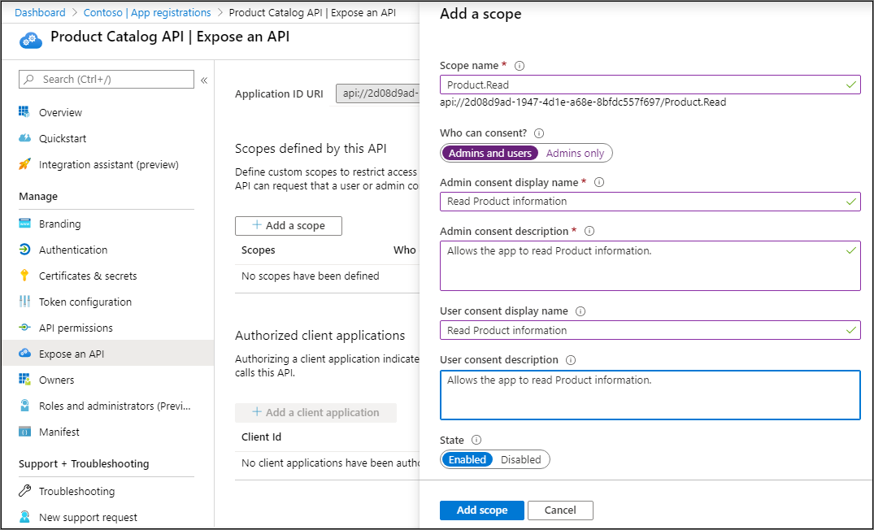
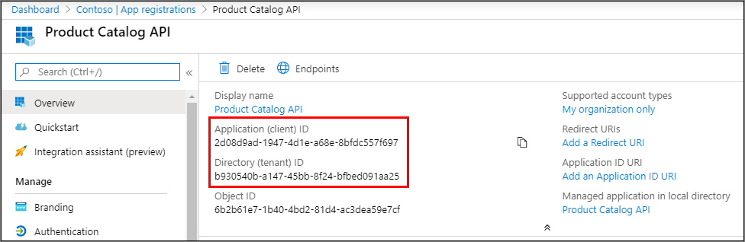
注册 Azure AD 应用
注册新 Azure AD 应用
定义任何自定义权限（范围）， Web API 将利用这些权限。
复制新应用的 租户 ID 和客户 ID
Notes:
The first step is to register the app in Azure AD using the Azure AD admin center located at https://aad.portal.azure.com.
Once the app is registered, you can then define the delegated permissions, also called *scopes*, your API exposes.
You then will write the business logic within your web API to determine what is allowed or prohibited based on the scopes and user identity listed in the access token received in the HTTP request.
Each scope has name & description properties for the user consent and admin consent. User consent is when a user grants an app permission to act on their behalf while admin consent is when a global tenant administrator grants the permission on behalf of all users or an application.
After registering the app in the Azure AD admin center, make a copy of the tenant ID and the client ID of the app. You'll need these values when you create configure the web API project.

Slide 10
用 Azure AD 保护 API
验证 API 中收到的访问令牌
使用现有的库和中间件（可用于大多数平台）
应用并强制执行权限！
委托权限不能超过登录用户的允许操作范围
Notes:
Microsoft identity only returns blobs of text as the access tokens. Your API should always validate the access tokens and ensure they were provided by Microsoft identity. Access tokens are signed with a private key. You can verify their authenticity with the matching public key.
Microsoft identity provides libraries and middleware, available for most platforms, to simplify this process.
Your custom API should also enforce permissions using the scopes included in the provided access tokens. Delegated permissions should never exceed what the signed-in user is allowed to do.

Slide 11
编写安全 Web API 的代码
下一步是对 Web API 项目进行编码。
控制台
C#
public void ConfigureServices(IServiceCollection services) { services.AddAuthentication(JwtBearerDefaults.AuthenticationScheme) .AddMicrosoftIdentityWebApi(Configuration.GetSection("AzureAd")); services.AddControllers(); services.AddSwaggerGen(c => { c.SwaggerDoc("v1", new OpenApiInfo { Title = "ProductCatalog", Version = "v1" }); }); }
public List<Product> GetAllProducts()
{
HttpContext.VerifyUserHasAnyAcceptedScope(new string[] {
"Product.Read" });
return data.Products;
}
dotnet new webapi -o ProductCatalog -au singleorg
Notes:
The next step is to code the web API project. Once the project is created, you'll have to do a little configuration to associate the project with the registered Azure AD app.
After configuring the web API project with the registered Azure AD app, you can then code the web API.
Start by creating a new .NET Core web API project using the following command:
dotnet new webapi -o ProductCatalog -au singleorg
This command will create a new web API that has most of the code necessary for securing it with Microsoft identity using the Azure AD registered app.
First, associate the web API with the Azure AD app by setting the TenantId and ClientId properties in the appsettings.json file.
Next, use the existing Startup.cs file to configure the authentication settings for the web API. Update the ConfigureServices() method in the Startup class in the root of the project to contain the following code:
public void ConfigureServices(IServiceCollection services) { services.AddAuthentication(JwtBearerDefaults.AuthenticationScheme) .AddMicrosoftIdentityWebApi(Configuration.GetSection("AzureAd")); services.AddControllers(); services.AddSwaggerGen(c => { c.SwaggerDoc("v1", new OpenApiInfo { Title = "ProductCatalog", Version = "v1" }); }); }
This code uses the Microsoft.Identity.Web NuGet package to configure the web application to use Microsoft identity and the MSAL.NET SDK.
Finally, use the VerifyUserHasAnyAcceptedScope() method within your controller's action methods to verify the current request includes the necessary permissions scopes. If it doesn't, it throws an error. Otherwise, it will continue and execute the desired result.
public List<Product> GetAllProducts() { HttpContext.VerifyUserHasAnyAcceptedScope(new string[] { "Product.Read" }); return data.Products; }

Slide 12
演示
使用 Microsoft 身份保护自定义 API
使用 Microsoft 身份保护自定义 API
Notes:
See the file M01_Manage roles and create teams.docx for instructions for this demonstration.​
​Demonstrations references in this deck utilize a Microsoft 365 E5 tenant and access to Microsoft Teams.
Set up instructions -Set up can take up to 60min
https://microsoft.sharepoint.com/:w:/t/FY20BaselineLocalEventsPlanning/ERs4HL_d3RNFiwERCPC3mGMBkKo0lIjdgJb_r78bpJYWyg?e=wIQtUi
​

Slide 13
从 Web 应用调用受保护的 API
Notes:
Now let's see how to create and configure a web app so that it can access a secured web API.

Slide 14
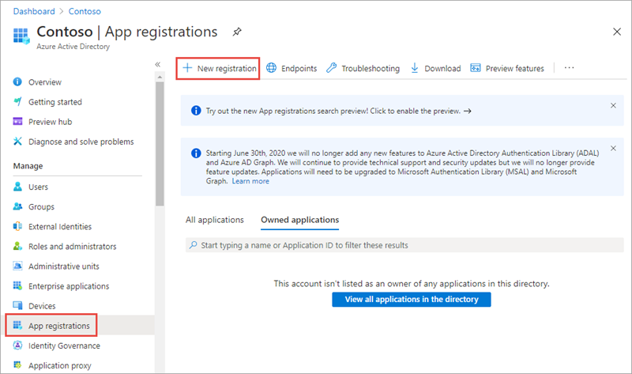
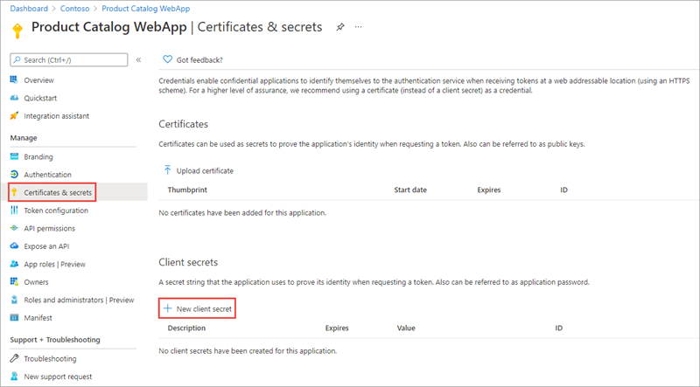
创建由 Microsoft 身份保护的网络应用
调用 Web API 的 Web 应用是机密客户应用。
用 Azure AD 注册一个密钥（应用密码或证书）
Notes:
The first step is to register a new Azure AD app in the Azure AD admin center that will represent the web application.
The important part of the app registration is the creation of an app secret. This secret, along with the client ID of the app, are used by the web application to authenticate with Microsoft identity when it requests an access token.
Web apps that call web APIs are confidential client applications. That's why they register a secret (an application password or certificate) with Azure AD.
NOTE:
Use certificates instead of app secrets in production environments

Slide 15
配置 Web 应用以调用受保护的 API
下一步是创建 Web 应用，使用户能够登录，然后访问受保护的网络 API。
控制台
dotnet new mvc --auth SingleOrg dotnet add package Microsoft.Identity.Web dotnet add package Microsoft.Identity.Web.UI
Notes:
The next step is to create the web application that will allow the user to sign in and then access the secured web API.
Create a new ASP.NET Core MVC application using the following command (see slide) , followed by installing a few NuGet packages to support and Microsoft identity.

Slide 16
更新 Web 应用以支持 Microsoft 身份的用户登录
现在更新项目，将其与你为 Web 应用注册的 Azure AD 应用相关联。
C#
public void ConfigureServices(IServiceCollection services) { services.AddAuthentication(OpenIdConnectDefaults.AuthenticationScheme) .AddMicrosoftIdentityWebApp(Configuration.GetSection("AzureAd")) .EnableTokenAcquisitionToCallDownstreamApi(Constants.ProductCatalogAPI.SCOPES) .AddInMemoryTokenCaches(); services.AddControllersWithViews(options => { var policy = new AuthorizationPolicyBuilder() .RequireAuthenticatedUser() .Build(); options.Filters.Add(new AuthorizeFilter(policy)); }); services.AddRazorPages() .AddMicrosoftIdentityUI(); }
Domain：你注册 Azure AD 应用的Azure AD 租户的域
TenantId：你注册 Azure AD 应用的 Azure AD 租户的 ID
ClientId：你的 Azure AD 应用的 ID
ClientSecret：你的 Azure AD 应用的密钥
Notes:
The next step is to configure the web app’s controllers and views to use the authentication configuration you just setup.
Open the appsettings.json file and set the details of the registered Azure AD application you previously created. This includes details such as:
Domain: the domain of your Azure AD tenant where you registered the Azure AD application
TenantId: the ID of your Azure AD tenant where you registered the Azure AD application
ClientId: the ID of your Azure AD application
ClientSecret: the secret of your Azure AD application
Next, configure the web app's authentication by updating the ConfigureServices() method in the Startup class for the project (see code sample). This code will configure the web app's middleware to support Azure AD for authentication and to obtain an ID token:
At this point, the web app is associated with the registered Azure AD app and configured to support users signing in with their Microsoft identity account.

Slide 17
添加令牌获取
下一步是创建控制器来实现网站上的页面。
C#
C#
[AuthorizeForScopes(Scopes = new[] { Constants.ProductCatalogAPI.CategoryReadScope })] public async Task<ActionResult> Index() { var client = new HttpClient(); var accessToken = await tokenAcquisition.GetAccessTokenForUserAsync(Constants.ProductCatalogAPI.SCOPES); client.DefaultRequestHeaders.Authorization = new AuthenticationHeaderValue("Bearer", accessToken); var json = await client.GetStringAsync(url); var serializerOptions = new JsonSerializerOptions { PropertyNamingPolicy = JsonNamingPolicy.CamelCase }; var categories = JsonSerializer.Deserialize(json, typeof(List<Category>), serializerOptions) as List<Category>; return View(categories); }
public CategoriesController(ITokenAcquisition tokenAcquisition) { this.tokenAcquisition = tokenAcquisition; }
Notes:
The last step is to update your controllers to use the custom scopes defined by the API.
When the user requests one of these pages, the web app already has an access token for the user. This token is used, in addition to the web app's Azure AD app details, to obtain a new access token. The resulting access token is intended to be used with the web API but is for the web app to use.

Slide 18
从守护进程应用调用受保护的 API
Notes:
This topic covers how to add app roles to an Azure AD Application registration and consume a secured API from a daemon application.

Slide 19
使用守护进程应用访问 Microsoft 身份保护的 Web API
在没有用户互动的情况下运行的应用称为服务或守护进程应用。
在获得访问令牌之前要求管理员对配置的权限给予同意
实施 OAuth 2.0 客户端凭据流
守护进程应用示例：
用于提供或管理用户或在目录中进行批处理的 Web 应用
执行批处理工作的桌面应用（如 Windows 的 Windows 服务或 Linux 的守护进程），或在后台运行的操作系统服务
需要操作目录的 Web API，而不是特定的用户
Notes:
Apps that run without user interaction are referred to as services or daemon apps. A daemon is an application that runs, typically on a schedule, and doesn't require a user to be involved in the process. An administrator does need to go through a consent process to grant the daemon the necessary permissions to call a web API.
Unlike the apps that have a user involved and implement the on-behalf-of flow, daemon apps implement the client credentials flow.
Some examples of use cases for daemon apps include the following scenarios:
Web applications that are used to provision or administer users or do batch processes in a directory
Desktop applications (like Windows services on Windows or daemon processes on Linux) that do batch jobs, or an operating system service that runs in the background
Web APIs that need to manipulate directories, not specific users
There's another common case where non-daemon applications use client credentials: even when a daemon does act on behalf of a user, the daemon needs to access a web API or a resource under own their identity for technical reasons. For example, accessing to secrets in Azure Key Vault or querying Azure SQL Databases.
Damon applications, like applications that implement the on-behalf-of flow, are confidential client applications. These apps, given that they access resources independently of users, need to prove their identity. They're also sensitive apps and they must be approved by the Azure AD tenant admins.

Slide 20
创建能够调用 Microsoft 身份保护的 Web API 的守护进程应用
注册一个新 Azure AD 应用，并为该应用配置一个应用密钥。
Notes:
Now let's see how to create and configure a daemon app that can access a secured web API.
The first step is to register a new Azure AD app in the Azure AD admin center that will represent the web application.
The important part of the app registration is the creation of an app secret. This secret, along with the client ID of the app, are used by the daemon app to authenticate with Microsoft identity when it requests an access token.
[!IMPORTANT] It's recommended to use a certificate instead of a client secret for production apps.
[!NOTE] Unlike web apps, a daemon app doesn't require a redirect URI. Daemon apps don't have a user experience, nor is a user involved, so there is no need to redirect a user to a web page.

Slide 21
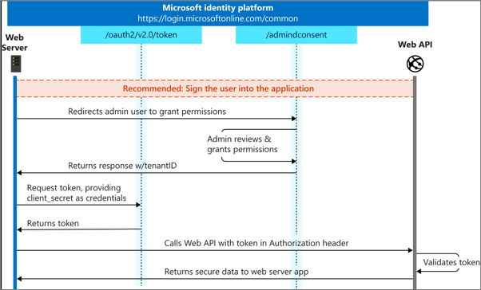
客户端凭据授予流程
守护进程应用实现 OAuth 2.0客户端凭证授予流程，以便从 Microsoft 身份获得访问令牌。
Notes:
Daemon apps implement the OAuth 2.0 client credentials grant flow to obtain an access token from Microsoft identity. This flow permits a confidential client to use its own credentials to authenticate the app when calling a web API.
Your application can acquire a token to call a web API on behalf of itself (not on behalf of a user). This scenario is useful for daemon applications.
The first step an admin user must do is to grant the specified permissions to the daemon app. Once permissions have been granted via an admin consent experience, the app can request an access token.
The daemon submits a request to the Azure AD token issuing endpoint and includes its client ID and client secret (or certificate).

Slide 22
配置守护进程应用以调用受保护的 API
下一步是创建将获得访问令牌的守护进程应用，然后访问受保护的 Web API。
控制台
dotnet new console dotnet add package Microsoft.Identity.Client dotnet add package Microsoft.Extensions.Configuration dotnet add package Microsoft.Extensions.Configuration.Binder
Notes:
The next step is to create the daemon app that will obtain an access token and then access the secured web API.
Create a new .NET Core console app using the following command (see slide), followed by installing a few NuGet packages to support and Microsoft identity.

Slide 23
更新应用以支持 Microsoft 身份
更新项目以便其使用 Microsoft 身份进行身份验证并获取访问令牌，并添加代码以调用 Web API。
C#
var httpClient = new HttpClient(); var defaultRequestHeaders = httpClient.DefaultRequestHeaders; // add ACCEPT header if not present if (defaultRequestHeaders.Accept == null || !defaultRequestHeaders.Accept.Any(m => m.MediaType == "application/json")) { httpClient.DefaultRequestHeaders.Accept.Add(new MediaTypeWithQualityHeaderValue("application/json")); } // add AUTHORIZATION header with access token defaultRequestHeaders.Authorization = new AuthenticationHeaderValue("bearer", result.AccessToken); // call web API endpoint HttpResponseMessage response = await httpClient.GetAsync($"{{WEB_API_ENDPOINT}}/api/Categories"); if (response.IsSuccessStatusCode) { string json = await response.Content.ReadAsStringAsync(); var results = JsonDocument.Parse(json); // display results }
C#
IConfidentialClientApplication app = ConfidentialClientApplicationBuilder.Create("{{CLIENT_ID}}) .WithClientSecret("{{CLIENT_SECRET}}") .WithAuthority(new Uri("https://login.microsoftonline.com/{{TENANT_ID}}")) .Build(); string[] scopes = new string[] { "api://{{CLIENT_ID}}/.default" }; AuthenticationResult result await app.AcquireTokenForClient(scopes).ExecuteAsync();
Notes:
Now update the project so it will authenticate with Microsoft identity and obtain an access token (code sample – left)
The scope to request for a client credential flow is the app ID followed by /.default. This tells Azure AD to use the application level permissions declared statically during the application registration.
The last step is to add code to call the web API (code sample – right)

Slide 24
在自定义应用和 API 中与用户、组和角色一起工作
Microsoft 身份中基于角色的访问控制
在使用 Microsoft 身份保护的自定义应用和 API 中使用安全组。
在自定义应用中利用应用角色
Notes:
In this section, you’ll learn how to use both Azure AD Groups and Application Roles to provide fine grained access control to an application.

Slide 25
Microsoft 身份中基于角色的访问控制
Notes:
Role-based access control (RBAC) is a popular mechanism to enforce authorization in applications. The administrator assigns roles to different users and groups to control who has access to what content and functionality.
In this unit, you’ll learn how Microsoft identity enables developers and administrators to secure and grant access to custom apps.

Slide 26
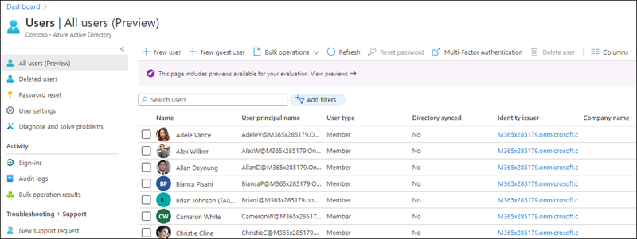
概述
使用 Microsoft 身份配置的自定义应用，以支持登录用户接收有关用户的信息。 其中包括个人资料信息，但也可以包括他们所属的组或分配给他们的应用角色。
你的自定义应用可以使用此信息，并且在应用具有必要权限的情况下，允许用户从应用中编辑其详细信息。
Notes:
Microsoft identity enables developers to build custom applications and secure them in different ways. You can configure your custom apps to support users signing-in using their personal or consumer Microsoft Account or with their Work or School account.
An app can then grant users the ability to do specific tasks depending who they are, what groups they belong to or what roles they've been granted within the application.
Users are managed from the Azure AD admin center (https://aad.portal.azure.com) including users within your organization and those added as guests in business-to-business (B2B) scenarios.
In addition to users, administrators (and other people with the appropriate access) can use the Azure AD admin center to create and manage security groups that contain collections of users, groups, and roles specific to your custom app.
Custom apps that are configured with Microsoft identity to support users signing-in receive information about the user. This includes profile information such as their name and email address, but can also include the groups they belong to or app roles they've been assigned to. Your custom app can use this information and, in the cases where the app has the necessary permissions, enable the user to edit their details from within the app.

Slide 27
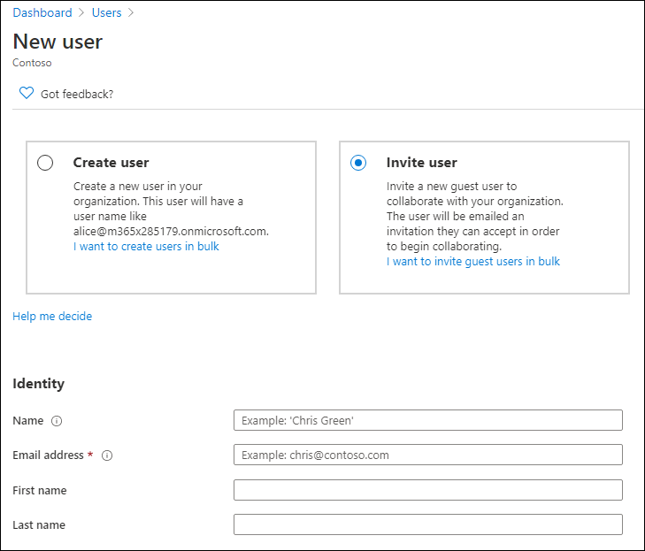
添加或删除用户
要将用户添加到组织中，请首先登录 Azure AD 管理中心，然后选择用户导航选项以打开所有用户边栏。
Notes:
To add a user to your organization, first sign-in to the Azure AD admin center and select the Users navigation option to open the All users blade.
Select the New user button in the navigation to enter the user's information. Some fields are required, such as the name, username, and password, while others are optional such as the groups they belong to and job information.
To add a guest user to your organization, select New guest user where you can either create a user or invite an existing user via email.

Slide 28
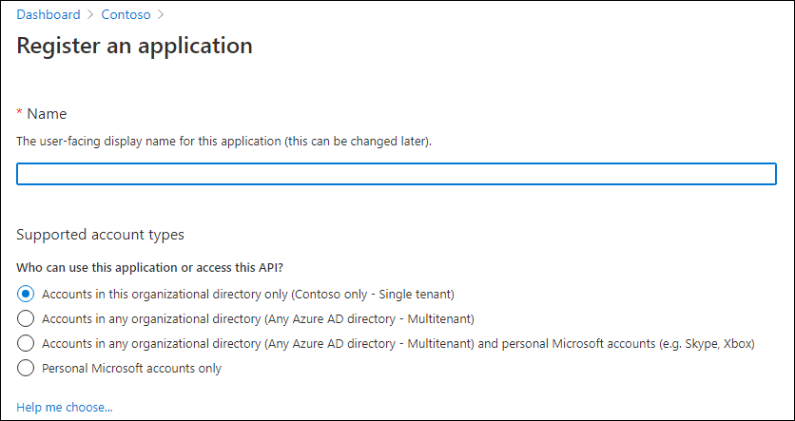
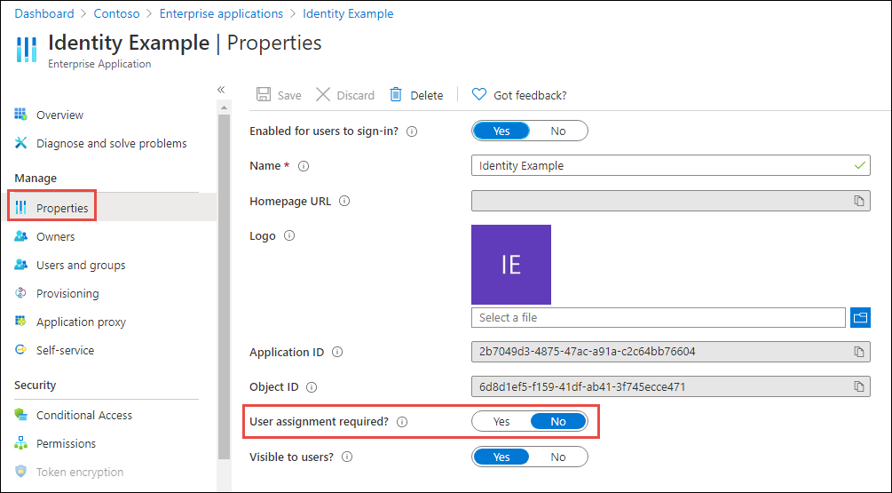
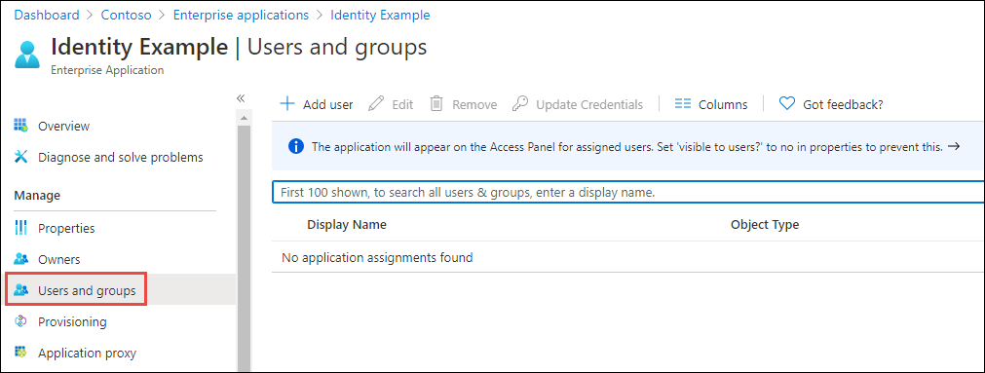
将应用限定给特定用户
默认情况下，Azure AD 应用允许组织中的所有用户登录到应用
可以选择通过启用“需要用户分配”属性来禁用此功能
从 Azure AD 管理中心手动将用户分配给应用
Notes:
When you register an app in Azure AD, you specify what types of accounts it will support.
Each of the account types supported provides slightly different options. However, each of the options includes all users in the organization where the app is registered. This means any user within the **All users** blade can sign into your custom app.
Microsoft identity supports restricting an app to a certain set of users or security groups within your tenant.
To restrict an application to a subset of users, first enable the setting on the app by selecting **Enterprise Applications** from the **All applications** menu item within the Azure AD admin center:
Select an app, then select the **Properties** navigation item, enable the toggle for the **User assignment required** property, and save your changes:
Once the property has been set, you can use the **Users and groups** blade within the app to manage the list of users and groups who can sign in and access your app:

Slide 29
基于角色的访问控制 (RBAC)
RBAC 帮助你管理资源、用户可以访问应用的哪些区域以及他们利用这些资源的目的。
RBAC 通过将用户添加到角色来简化分配
应用开发人员可以：
检查登录用户是否具有特定角色
允许或阻止访问具有属性的特定端点
Notes:
While administrators can control which users have access to an app using the User assignment required property, developers would need to account for specific users within the app.
RBAC helps you manage resources, what areas of an app users have access to and what they can do with those resources.
Developers first create a role definition within the app's registration in the Azure AD admin center. The code within the app can check if the user has access to certain resources based on the roles assigned to the user.
This pattern simplifies management as the app developer can define the roles, while administrators can grant users to these roles without requiring updates to the app's code.

Slide 30
代码配置
在 Azure AD 中注册应用后，下一步是配置 Web 应用。
C#
@if (User.Identity.IsAuthenticated) { <div> <table cellpadding="2" cellspacing="2"> <tr> <th>Claim</th> <th>Value</th> </tr> @foreach (var claim in User.Claims) { <tr> <td>@claim.Type</td> <td>@claim.Value</td> </tr> } </table> </div> }
JSON
{ "AzureAd": { "Instance": "https://login.microsoftonline.com/", "Domain": "qualified.domain.name", "TenantId": "22222222-2222-2222-2222-222222222222", "ClientId": "11111111-1111-1111-11111111111111111", "ClientSecret": "", "CallbackPath": "/signin-oidc" } }
Notes:
In order for a web app to use Microsoft identity to enable users to authenticate and obtain access tokens for use with services such as Microsoft Graph, you must register a new app with Azure AD. With the app registered in Azure AD, the next step is to configure the web app. For an ASP.NET Core web application, most of these settings are saved in the appsettings.json file.
Open this file and set the three values you collected from registering the Azure AD app (JSON code sample). You may have to create a key for the client secret.
There are three things you'll need from the Azure AD app registration:
- **Tenant ID**: ID of your Azure AD directory
- **Client ID**: unique autogenerated ID of the app (*this is also referred to as the application ID*)
- **Client secret**: secret you created during app registration
Finally, OpenID Connect middleware contains default mapping of claims in the OpenID tokens to user properties in ASP.NET Core. Use these properties in your web app.
Update the user experience of the web application to display all the claims in the OpenID Connect ID token that is provided by Azure AD when the user signed in. (C# code sample)

Slide 31
在使用 Microsoft 身份保护的自定义应用和 API 中使用安全组。
Notes:
Let’s talk about security groups and how you can use them within your custom apps secured with Microsoft identity.

Slide 32
用 Azure AD 组管理应用访问
利用具有 Microsoft 身份的自定义应用中的安全组。
组简化了访问管理和向单个用户授予权限的工作
组可以配置为允许用户自己查找和加入组
可以选择自动批准加入请求，或需要组所有者的明确批准
Notes:
Azure Active Directory (Azure AD) lets you use groups to manage access to your cloud-based apps, on-premises apps, and your resources. Your resources can be part of the Azure AD organization, such as permissions to manage objects through roles in Azure AD, or external to the organization, such as for Software as a Service (SaaS) apps, Azure services, SharePoint sites, and on-premises resources.
Azure AD helps you give access to your organization's resources by providing access rights to a single user or to an entire Azure AD group. Using groups lets the resource owner assign a set of access permissions to all the members of the group, instead of having to provide the rights one-by-one. The resource or directory owner can also give management rights for the member list to someone else, such as a department manager or the support department administrator, letting that person add and remove members, as needed.
The resource owner of a group can also enable users to find their own groups to join instead of explicitly assigning users to groups. Groups can be configured to automatically accept all user join requests or to require approval.

Slide 33
自定义应用和 API 中的安全组
自定义应用可以请求用户组成员的身份，以提供或限制对应用中的某些功能的访问。
JSON
{ ... "optionalClaims": { "idToken": [ { "name": "groups", "source": null, "essential": false, "additionalProperties": [ "emit_as_roles" ] } ], "accessToken": [], "saml2Token": [] } ... }
Notes:
Custom apps can request a user's group membership as a way to provide or restrict access to certain functionally within the app.
By default, the ID and Access tokens provided by Microsoft identity only contain basic information about the current user. Security groups the user is a member of aren't included in the tokens.
To add them to the ID token, set the groupMembershipClaims property to SecurityGroup or All in the manifest of the registered Azure AD app from the Azure AD admin center.
The code you will write in ASP.NET Core will add the groups to the role claim instead of the group claim, so there is one more thing you need to change. Locate the optionalClaims property as update it to set idToken to include additional properties that will return the groups as roles:
{ ... "optionalClaims": { "idToken": [ { "name": "groups", "source": null, "essential": false, "additionalProperties": [ "emit_as_roles" ] } ], "accessToken": [], "saml2Token": [] } ... }

Slide 34
代码配置
在 ASP.NET 中，你可以通过在方法中加上 [授权] 属性来保护一个控制器，只有通过认证的用户才能进行访问。
C#
@if (User.IsInRole("22222222-2222-2222-2222-222222222222")) { <li class="nav-item"> <a class="nav-link text-dark" asp-area="" asp-controller="Products" asp-action="Index">Products</a> </li> }
C#
[Authorize(Roles("22222222-2222-2222-2222-222222222222"))] public class ProductsController : Controller { }
Notes:
In ASP.NET, you can secure a controller so only authenticated users can access it by decorating it the method with the [Authorize] attribute. This attribute also supports securing the endpoint based on a security group.
After configuring the OpenID Connect middleware to use Microsoft identity as the role claim, you can specify the ID of a group to secure the controller (see sample #1)
You can also use the group information in code using the user.IsInRole("22222222-2222-2222-2222-222222222222") method. For example, the following code (sample #2) will only show the Products navigation link if the user is in a specific group

Slide 35
演示
在自定义应用和 API 中与用户、组和角色一起工作
在使用 Microsoft 身份保护的自定义应用和 API 中使用安全组。
Notes:
See the file M01_Manage roles and create teams.docx for instructions for this demonstration.​
​Demonstrations references in this deck utilize a Microsoft 365 E5 tenant and access to Microsoft Teams.
Set up instructions -Set up can take up to 60min
https://microsoft.sharepoint.com/:w:/t/FY20BaselineLocalEventsPlanning/ERs4HL_d3RNFiwERCPC3mGMBkKo0lIjdgJb_r78bpJYWyg?e=wIQtUi
​

Slide 36
在自定义应用中利用应用角色
Notes:
Application roles are used to assign permissions to users and apps. These roles are defined in the registered Azure AD app’s manifest.
In this unit, you’ll learn how to add app roles to an Azure AD registered app, grant users, and groups to the role and use the app role within a custom app secured with Microsoft identity.

Slide 37
自定义应用和 API 中的应用角色
RBAC 使管理员能够向角色与个人或组授予权限
管理员为用户和组分配角色，以控制操作和访问
开发人员可以在其应用中安全地执行授权，而不需要花费太多精力
应用角色是在 Azure AD 管理中心的应用注册清单中定义的。
Notes:
Role-based access control (RBAC) is a popular mechanism to enforce authorization in applications. The administrator can assign roles to different users and groups to control who has access to what content and functionality.
Using RBAC with Application Roles and Role Claims, developers can securely enforce authorization in their apps with little effort on their part.
These application roles are defined in the Azure AD admin center in the application's registration manifest. When a user signs into the application, Azure AD emits a roles claim for each role that the user has been granted individually and from their group membership. Assignment of users and groups to roles can be done through the portal's UI, or programmatically using Microsoft Graph.

Slide 38
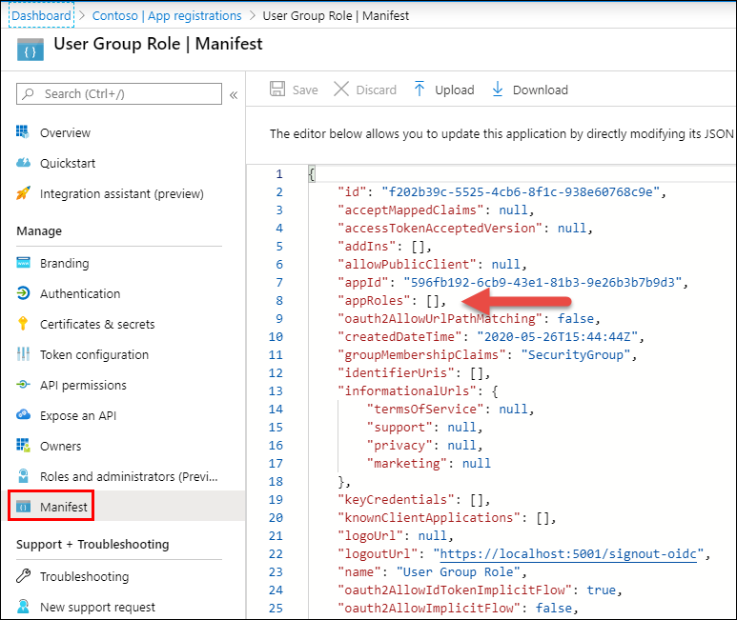
声明应用的角色
在 Azure AD 管理中心的应用中管理的应用角色
JSON
"appRoles": [ { "allowedMemberTypes": [ "User" ], "description": "Administrator role for Product Catalog web application.", "displayName": "ProductAdministrators", "id": "98ce9517-557f-4ac5-b827-f18d948ee552", "isEnabled": true, "lang": null, "origin": "Application", "value": "ProductAdministrators" }, { "allowedMemberTypes": [ "User" ], "description": "Viewer role for Product Catalog web application", "displayName": "ProductViewers", "id": "7465fed6-02cc-467c-87c2-fa6e0bf4f929", "isEnabled": true, "lang": null, "origin": "Application", "value": "ProductViewers" } ]
Notes:
App roles can be managed from the Azure AD admin center.
Select an application in the Azure AD admin center. Roles are defined in the app's manifest that is accessible from the **Manifest** navigation item.
Locate the `appRoles` setting in the manifest (see screenshot)
[!IMPORTANT] The displayName property can't contain any spaces.

Slide 39
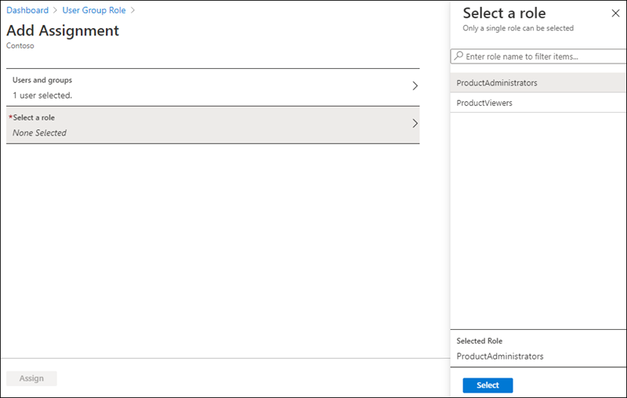
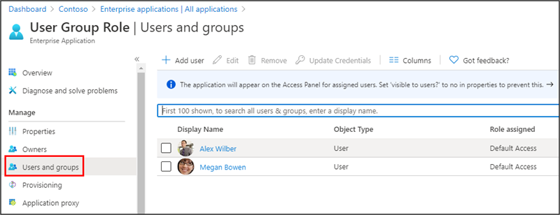
将用户和组添加到角色中
在应用清单中定义应用角色后，可以将用户添加到角色中。
Notes:
After defining the app roles within the app's manifest, you can now add users to the role.
From the Enterprise application blade in the Azure AD admin center, select the application and then select the Users & Groups navigation item. (image 1)
Select Add User. On the Add Assignment blade, select the users or groups you want to add to the app role. Then select the app role or app roles to add the user or groups (image 2)

Slide 40
代码配置
在 ASP.NET 中，你可以通过在方法中加上 [授权] 属性来保护一个控制器，只有通过认证的用户才能进行访问。
C#
C#
[Authorize(Roles = ("ProductAdministrators"))] public ActionResult Create() { var viewModel = new ProductViewModel() { Categories = data.Categories }; return View(viewModel); } [Authorize(Roles = ("ProductAdministrators"))] [HttpPost] [ValidateAntiForgeryToken] public ActionResult Create([Bind("ProductName", "CategoryId")] ProductViewModel model) { if (ModelState.IsValid) { data.Products.Add(new Product() { Id = data.Products.Max(p => p.Id) + 1, Name = model.ProductName, Category = new Category { Id = model.CategoryId } }); return RedirectToAction("Index"); } return View(model); }
[Authorize(Roles=("ProductViewers,ProductAdministrators"))] public class ProductsController : Controller { }
Notes:
In ASP.NET, you can secure a controller so only authenticated users can access it by decorating it the method with the [Authorize] attribute. This attribute also supports securing the endpoint based on an app role. (sample 1 on slide)
You can also use the [Authorize] attribute to secure specific methods on the endpoint. For example, the following code will only allow ProductAdministrators the ability to create new products on the ProductsController (sample 2 on slide)

